Slide 1

What properties do I have time to visit?
Presented by – Christopher John Bond s376838
Supervised by – Dr Maria Spichkova
Notes:
Hello everyone, my name is Chris Bond,
my Thesis Supervisor is the awesome Dr Maria Spichkova
and my Thesis topic is "What properties do I have time to visit?"

Slide 2
Motivation
Finding a place to rent/buy is challenging
No route planning solution for property inspections
3.5 million Australians moved home in 2016[1]
Notes:
Finding a property to rent or buy in a large city like Melbourne is complex, there are many considerations, requiring careful planning.
Remember back to the last time you moved
For me it was a year ago for this house.
If you are anything like me you would look on realestate.com.au or domain the properties that matched your filters, save quite a few, look at the inspection list … then on my second screen I would open up google maps and go through the headache of weighing up which inspections you couldn’t make because of travel time.
Creating a plan like this is
A labourious process, and probably is for some of the 3 and a half million people who are likely moving every year.
N.B. as we saw in the last Australian census where data was released, there are quite a few people in the same boat.

Slide 3
Research Questions
PIRP different from existing domains?
Will a new algorithm or existing algorithm perform better in PIRP domain?
Are the proposed algorithm(s) within the order of magnitude of leading routing algorithms?
Notes:
To address this problem we posed 3 research questions:
First, whare are the attributes of property inspections, and how they are different from other planning problems
The goal of this was mainly to ensure we were examining something unique
Second, following this logic, can we use a close domain’s algorithm, and just tweak it a little for this new domain, and can we create a new algorithm? Which algorithm performs better, the modified old one, or new one?
Third, can those two algorithms perform within the runtime of something that already exist

Slide 4
Background
TSP
TSPP
VRP
PIRP – Property inspection route planning:
Day
Duration
Area Inspection
Time Windows
Preference
TSP minimise travel cost [2]
TSPP + maximise value + visit subset [3]
OP + fixed duration [4]
OPTW + time windows [4]
TOP
OP
TOPTW
TDTOP
TDOP
OPTW
TRSP
PIRP
Notes:
The next two slides answer Research Question 1.
Property Inspection route planning or PIRP, is the domain we created in this minor thesis. It is for creating a plan for property inspections.
And includes the following attributes, it occurs on a specified day, for a set duration, mimicking how people will regularly set aside a Saturday to view open homes.
It additionally has an attribute called area inspection, which involves looking at the amenities in the neighbourhood, like restaurants and train stations. Many people will do this to get a feel for the area and help them decide. But, if another inspection in that same area came up, you probably wouldn't look at the amenities again.
We found it has time windows of around 30 mins.
And people show preference for some locations over others.
Here are the domains we investigated and their relationship with one another. I'll just cover the main ones, but you can ask questions on the others.
The travelling salesman problem [hover] at the top is the seminal routing problem, which is no doubt familiar to most of you.
Where a list of locations or nodes must be visited, and each path between them (or edge) has a cost. In this problem we must visit all nodes, and the goal is to create a route that minimises travel cost.
Next, Travelling Salesman Problem with Profits, [hover], adds a varying value of each location, like how people exhibit preferences in property inspection, and it also removes the requirement to visit all locations.
Orienteering Problems [hover], add a fixed duration within which locations can be visited.
We found that the orienteering problem with time windows, [hover], was the closest domain in the literature to PIRP.
OPTW, simulates things like a tourist’s trip around points of interest in a city, where each location has an open and closed time, for example in Rome, the Colosseum is open from 8.30am-5pm and the Pantheon 8.30 to 7.30.
N.B.
The ’team’ variants of Orienteering Problems under TOP be explored in future work, it is used for multi-day planning. [hover] We kept it simple with OP.
TOP – multi-day [4] or multi-agent navigation [5] – future work
TOP - Also people tend to continually adjust their list of properties as more become available.
TRSP introduces service windows
VRP – road navigation [9]
TRSP – time windows (7]
TDOP – public transport schedules ([17])
The Time dependent variants, TDOP and TDTOP have been used to simulate public transit schedules.
We argue that the time window variants are the most similar to PIRP, this is TOPTW and OPTW.
The Vehicle routing problem (VRP) attempts to include road navigation, but it and its child Technician Routing Scheduling Problem TRSP, still aim to minimise the travel cost.

Slide 5
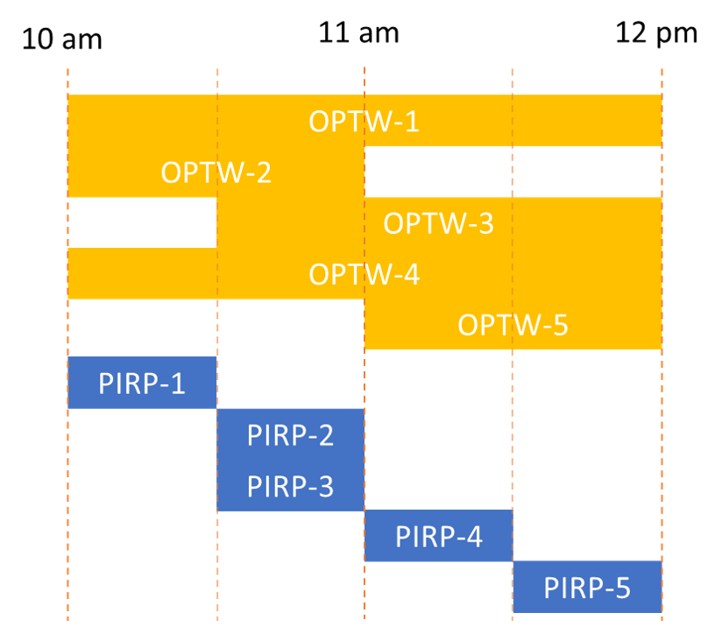
Background
Property Inspection Route Planning (PIRP) is different to OPTW:
Narrower time windows
Area Inspection
More accurate travel time estimates
Flexible travel mode
Iterated Local Search (ILS) is leading algorithm[7]
Existing algorithm PIRP-ILS
New algorithm PIRP-C
Notes:
There are a few differences between OPTW and PIRP.
The roman points of interest are pretty wide open times like the yellow bars, whereas a typical property inspection is likely to only be open for half an hour, like the blue bars. We 30 min metric found this when we surveyed over 10,000 inspections on a real estate website.
The second difference was the Area Inspection concept.
The third difference, is OPTW solutions use straight-line distance and average speeds to calculate travel times, this is a surprise. Directions APIs are not used, but people expect accuracy. We observed 11% time inaccuracy, leading to differences in results from 23% to 51%.
Fourth, the algorithms built to serve these domains, tended to use just one travel mode, but directions APIs enable car, public transit, cycling and walking.
Iterated Local Search or ILS, is the leading algorithm in the OPTW domain, so it is chosen for application in the PIRP domain.
We make sure that the existing algorithm, is adjusted to incorporate a directions API to serve point 3 and 4, and incorporate the area inspection concept, which is point 2.
We call this adjusted algorithm PIRP-ILS. To show it is the Iterated Local Search algorithm in the PIRP domain.
Generally this algorithm uses a stochastic approach to iteratively resolve the best combination and order of inspections.
Moreover, we built a new algorithm, called PIRP-C with all four points in mind from the beginning.
Given what we can see in this graphic, we created a more deterministic algorithm, because there were less possible combinations per steps.

Slide 6
Existing Algorithm Steps
Build – Selection operation
Improve – Shake, reorder and input new inspections operations
Notes:
The existing algorithm use a two phase approach.
An initial plan is built, this uses a selection operation
Secondly the plan is iteratively improved using shake, reordering and new inspection insertion operations.

Slide 7
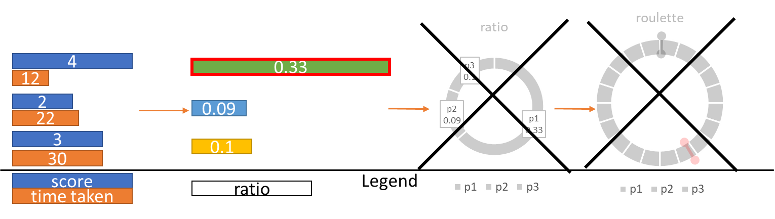
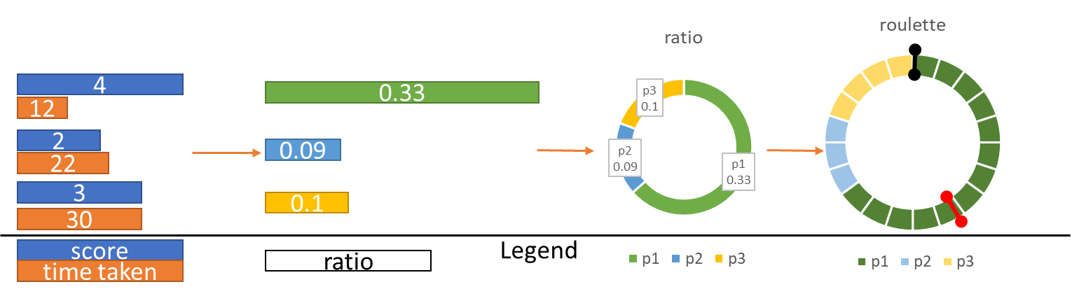
Existing Algorithm Operations – Selection [7]
Measure Preference Score (blue) and Travel Time (orange)
Calculate Ratio
Construct Pie Graph
Construct Roulette Wheel
Notes:
The existing algorithm has 4 steps as described here, we simplify it to two steps in the new algorith, [CLICK]
Because narrower time windows support a more direct approach
N.B
For the build phase, each inspection is added to the plan, by calculating the following, until the end of day is reached.
We look at all unscheduled inspections, and check the score in blue and travel time in orange.
We then create a ratio of the score over the travel time.
We combine these ratios into a pie graph.
Then divide it into a roulette wheel and run a random number generator to select the inspection. [Hover over red line]
In the new algorithm, [CLICK] we remove the final two steps, and just select the highest ratio
We think the more constrained time windows should lend itself to a more deterministic algorithm.

Slide 8
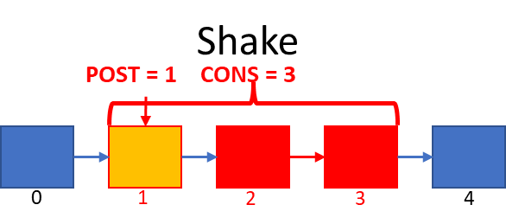
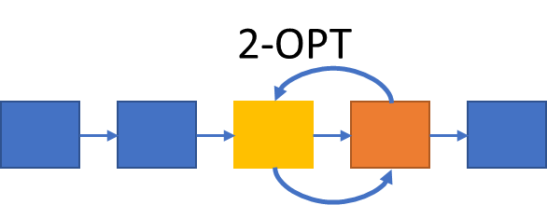
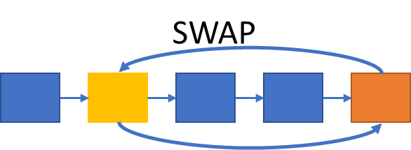
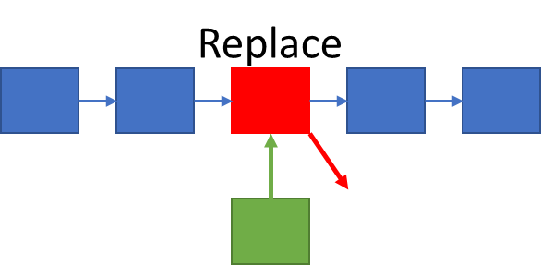
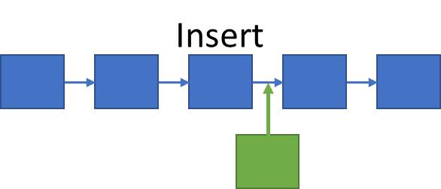
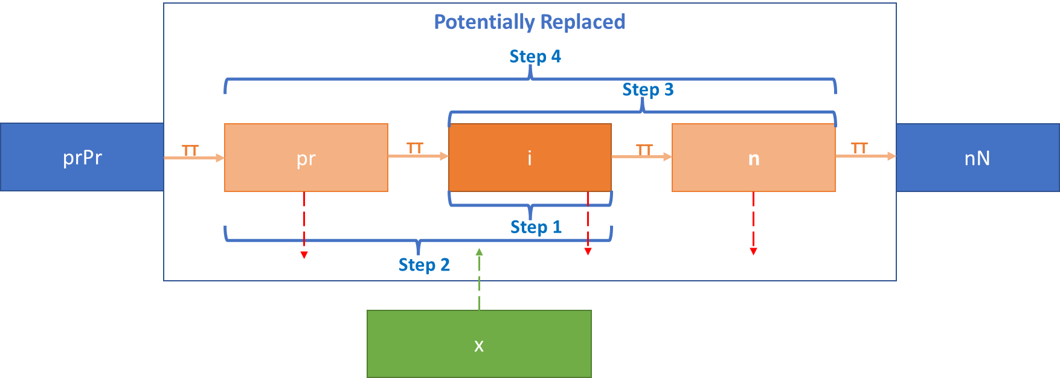
Existing Operations – Improve[7]
Shake – remove
Swap/2-OPT – reorder
Replace/Insert
– new inspections
Notes:
The second phase, improve, includes:
Shake – which removes some inspections, to escape a local maxima.
The Reorder methods – Swap and 2-OPT.
New inspections methods – Replace and Insert
[CLICK]
In our new algorithm the shake step, swap and 2-OPT are removed. Our trials showed they didn't add value.
N.B.
Revisiting the previous graphic, you can see that in each slot there are more viable alternatives in OPTW than in PIRP.
Replace is changed to new neighbourhood replace.
The reorder and new inspection methods test all pairs, and recalculate the entire route on success.
Swap reorders any two inspections, 2-OPT reorders any neighbouring inspections.
New inspections methods – Replace puts a new inspection in the place of an existing inspection, Insert places a new inspection in the plan in an appropriate location which is found by again testing all pairs, and recalculating the entire route

Slide 9
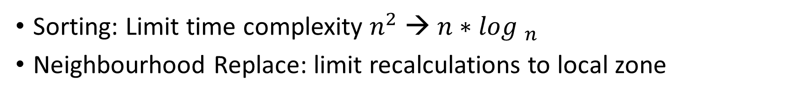
New Approach – Sorting and new Replace
Sorting: Limit time complexity $n^{2}$ →${ n∗log }_{n}$
Neighbourhood Replace: limit recalculations to local zone
Existing
New
Notes:
The primary novelty of our new algorithm is to use pre-sorting to reduce comparisons
- By sorting we can limit the comparisons from n squared time complexity to n log n complexity
- By changing comparisons from all-pairs to a window of 5 inspections
Secondly by changing the replace method, we can reduce the number of recalculations.
[CLICK]
In the existing approach a inspection is replaced, this could cascade to delay all later inspections, requiring recalculation, all the way down here.
In the new approach, we put a box around the replaced inspection, allowing these inspections to be removed if necessary. This stops any cascading recalculation.
N.B
The late start is the latest time we can begin an inspection within its blue inspection window, and be completed by the inspection window finish.
If someone inspects the property for 15 mins then the late start would be 15 mins before the inspection close.
The inspection might be started as early as the start of the window, based on the previous inspection, the scheduled times (in orange) happen anywhere between the early and late start times.
[CLICK]
If we consider a series of inspections, the previous inspection is in orange called "Scheduled Inspection", the red line is the finish time of the previous inspection.
TT is the travel time, the red boxes unviable times, green is are viable times.
A blue box shows the inspection is viable, a grey box shows it's unviable.
[CLICK]
In the last step, Area Inspections are added to durations. The clear cylinder represents is an area inspection previously conducted. The solid cylinders, still need to be done.

Slide 10
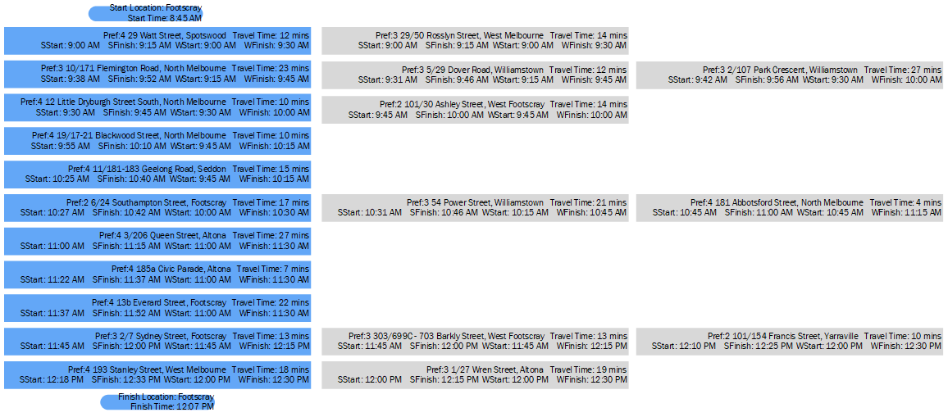












Experiment
Home PC
1,251 Datasets successful. 72 Datasets unsuccessful
Produced Visual Results
Hedonic Preferences[9]
Dataset
PIRP-ILS
PIRP-C
10 min
15 min
20 min
10 min
15 min
20 min
$$u^{2}$$
u
$$\sqrt{u}$$
$$u^{2}$$
u
$$\sqrt{u}$$
$$u^{2}$$
u
$$\sqrt{u}$$
$$u^{2}$$
u
$$\sqrt{u}$$
$$u^{2}$$
u
$$\sqrt{u}$$
$$u^{2}$$
u
$$\sqrt{u}$$
Notes:
In the experiment
Test Both Existing and new algorithm on home workstation.
- 1,251 datasets that were successfully tested,
- 72 datasets that were unsuccessfully tested
- These datasets didn't have sufficient records.
The dataset inputs were csv files.
All the inspection outputs were:
recorded in text files
and visually in a pdf like we have pictured here
These results include the selected inspections, in blue, and shortlisted inspections in grey.
The runtime of each step is recorded.
The I/O operations of reading in the csv input files, and outputting the results are not included in the runtime recording.
[CLICK]
In the selection approach
- in the existing algorithm they actually square the preference score at the first step
- We don’t know if this is a good idea for our domain
[CLICK]
So we run the experiment with the:
score preference squared,
the preference score unchanged,
and the preference score square rooted.
The inspections are also run with durations of 10, 15 and 20 minutes.
So each dataset is run 18 times in total
[CLICK]
- We use a hedonic preference approach for each property. Meaning if someone really likes a property it will get the highest score, 4.
N.B.
The Inspections and the Area Inspections are housed in separate csv files.
We use a hedonic preference approach with the most important with a score of 4, potentially important with a score of 3, medium importance with a score of 2 and low importance with a score of 1.
The range of percentages we use allows for constrained random assignment of value between these values for the records in a dataset.
An example would be 4% for most important, 16% for potentially important, 15% for medium importance and 65% for low importance category.

Slide 11
Results
Primary Experiment Data Features Measured:
Overall • Inspection Duration
Algorithm Stage • Number of Inspections
Mode • Sensitivity
Region
Effects of using API
Both perform within runtime of ILS @ 60 seconds
Notes:
We come to the results section.
We answer research question 2 over the next few slides, which is which algorithm is more fit for purpose for our domain
To show this we measure the overall results and also the results for the following data features.
Note the crossed out ones don't provide any interesting insights so I don’t present them.
Also I investigated the impact of using directions API on the outputs
Additionally, in the next slide we found that both algorithms perform in faster runtime than the parent domain algorithm ILS, even in worst case scenarios, answering research question 3, that both algorithms are fast enough.

Slide 12
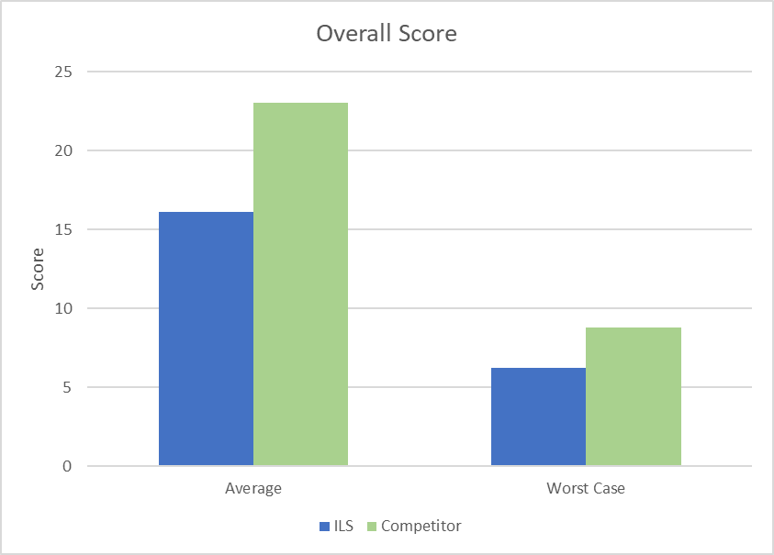
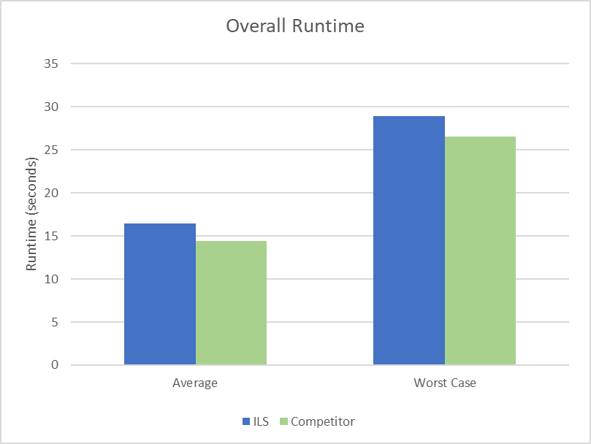
Overall Results
Score
Runtime
Notes:
Overall we found that the new algorithm (in green, named here as Competitor) results in a higher score and shorter runtime than the existing algorithm (in blue, named here as ILS) in the average case
I can describe in detail the worst case scenario, but suffice to say we examined a range of scenarios and found the new algorithm performs better in these scenario as well.
N.B.
The worst case is the first quartile for score, and the third quartile for runtime. Looking at both the average and worst case, shows us that there is a broad based trend in favour of PIRP-C.

Slide 13
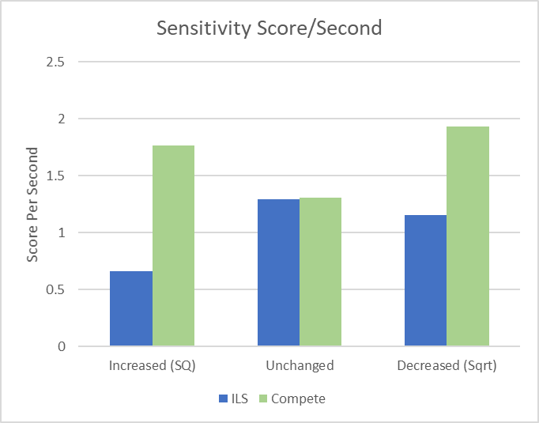
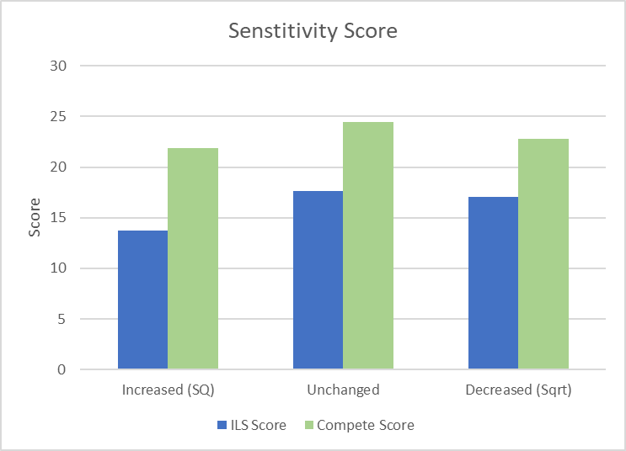
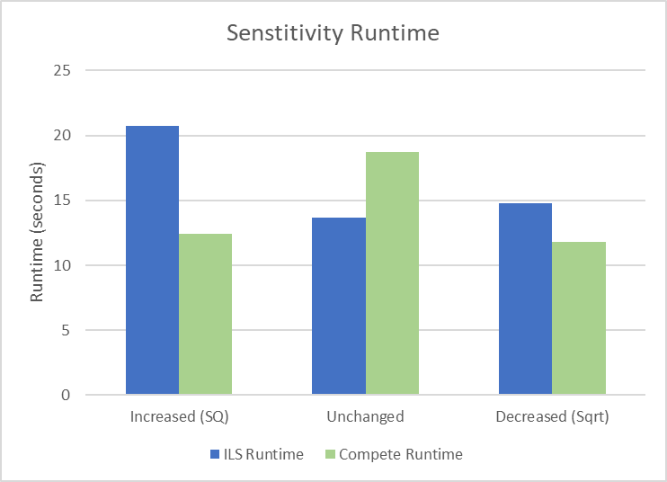
Preference Score Sensitivity Results
Score
Runtime
Ratio
Notes:
For all the data features we collected the final summed preference score, and the runtime.
To simplify the results, we divided the score by the runtime in seconds, to produce the one graph. This ratio graph. For the remaining datasets, I will present this one graph.
[CLICK]
The first data feature is the different preference score sensitivities.
This was the Squared, unchanged and Square Rooted preference scores.
We found that the existing algorithm performed best in the unchanged scenario,
and the new algorithm one performed better in the decreased score scenario.
But generally the new algorithm one performed better.
N.B.
We compared the sensitivity, which we've previously discussed of a squared score, unchanged score and square rooted score.
PIRP-ILS performed best when the score is unchanged, both the score is maximised and the runtime is minimised.
PIRP-C performed best when the score is minimised and the time value is maximised.
In the last graph we divide the score, by every second of runtime taken. To give a sense of both the score and runtime in one figure. This is done for the remaining data features.

Slide 14
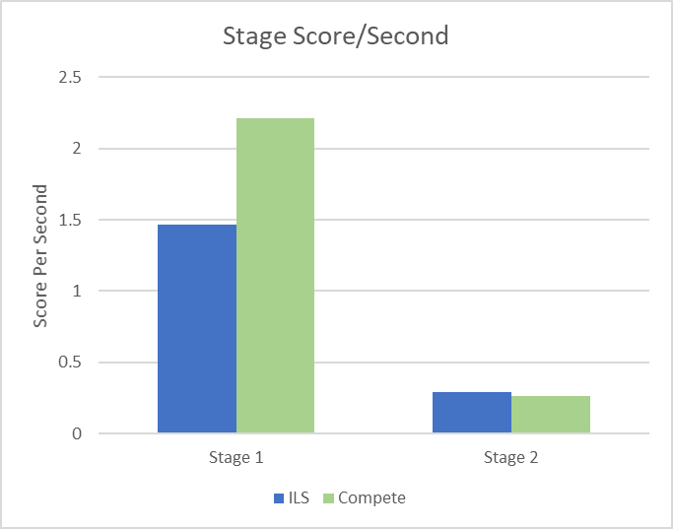
Stage Results
Notes:
If we have a look at each stage of the algorithm operation, this is the Stage 1 – Construct Phase, and Stage 2 Improve phase.
We can see there is a really potent effect of Stage 1 for the new algorithm.
We can see there’s room for improvement in stage 2, so our future work looks at alternative approaches.
Overall, I think the main reason why our Stage 1 construction step is so effective in our domain is the narrower time windows.
It's the same reason the more deterministic approach of new algorithm is more effective than the stochastic approach of existing algorithm.
N.B.
Given stage 2 must have stage 1 to operate, the thing we measure is Stage 1 and 2 combined.
As you can see in the far left graph, we get a great score from Stage 1 of the PIRP-C algorithm, and a decent amount from PIRP-ILS.
The score is only incrementally increased for both algorithms.
In our second graph we see a similarly short runtime for Stage 1 for both PIRP-C and PIRP-ILS. And fairly long runtimes once we include Stage 2

Slide 15
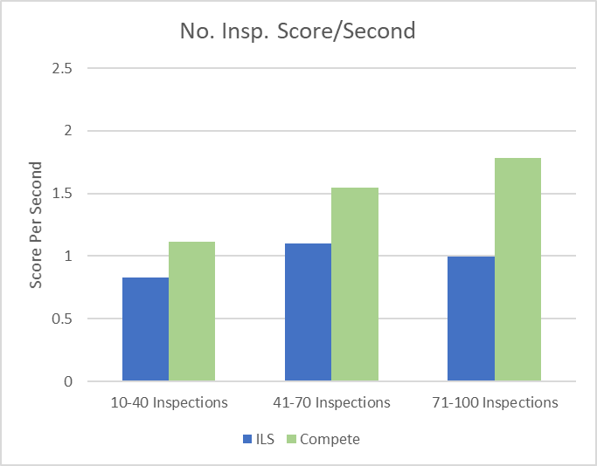
Number of Inspections Results
Notes:
When we include more inspections in a dataset, the scores increased, but the runtimes also increased.
For our new algorithm the runtimes didn’t increase by much, but in the existing algorithm it did, leading to this drop off in the final category.

Slide 16
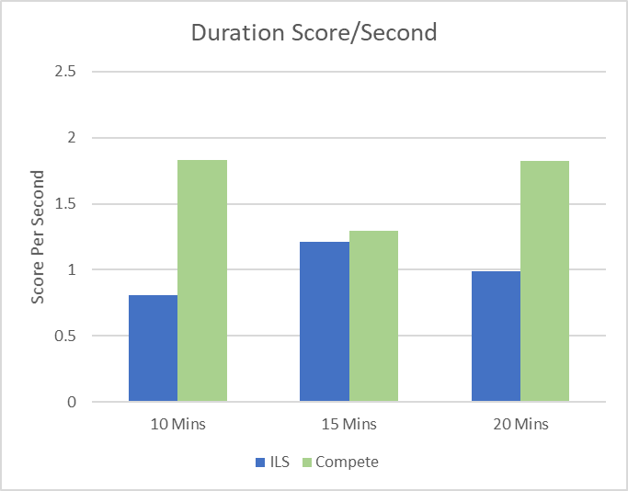
Inspection Duration Results
Notes:
We expected the inspection duration results to be the inverse of the previous slide, because smaller inspection durations meant more possible combinations.
But the 15 minute category confounded this pattern.
Future work will consider if the 15 minute result is replicable. Or if there are and other smaller trends that were missed.
Still the new algorithm performs better
N.B.
Conversely when we increase the amount of time in each inspection, we reduce the number of possible inspections to attend.
So the score is reduced.
Similarly the runtime is broadly reduced, with an interesting spike in PIRP-C runtime for 15 min inspections, that we couldn't explain.
This effects the ratio, but overall PIRP-C still performs better for the various situations.
Future work will consider if the 15 minute result is replicable. I think they will even out.
A preliminary re-analysis of the duration results indicate that runtime was actually less variable than published in the paper if extreme results are controlled for, as we see here.

Slide 17
Directions API Effects
Cost US$0.005/call
Each comparison = 1000 x longer
Existing 2.78 x more calls than new
Straight-Line Travel Time
New algorithm
Existing algorithm
With API → Without API
18.11
19.52
9.49
0.01
11.47
12.02
12.02
9.5
Average Score
Average Runtime (s)
Notes:
We knew it was important to include a directions API, but we recognise this had a significant impact on the algorithm calculation.
The cost of each API call was half a US cent.
We altered both the existing and new algorithms to not make API calls, and compared these Frankensteined algorithms with the ones we got the original results from
By looking step-by-step, we found it took about 1000 times longer for each calculation that uses an API call.
Important to use sparingly.
Generally we found the existing algorithm used almost 3 times more API calls than the new algorithm.
On the left are the results with API, on the right, results without API.
We can see there are mild improvements in the score from the API call results to the non-API call results.
These are based on inaccuracies, so are a false reading
Generally the API call will produce a slightly longer travel time due to extra distance and traffic than straight-line calculations.
The runtime changes, both algorithms have a 10 second soft cap on their operation.
For the existing algorithm, we see this ballooning out, because each iteration of step 2 has to be complete before the algorithm runtime is checked and it is stopped.
We see a really short runtime for the new algorithm because it gets an early mark when it is done with its step 2 comparison set.
Whereas the existing algorithm keeps trying to improve the solution.

Slide 18
Uncertainties
Likeness of existing algorithm
Dataset matches typical person
Desktop vs cloud Performance
Higher existing algorithm timelimit to resolve
Inspection duration inconsistency
Notes:
Things I’m not certain of are:
- How closely my modified algorithm matches the original ILS algorithm from the parent domain Orienteering Problem with Time Windows, given only a high level description of the operation was available
How closely the datasets match a typical person's saved property list, this is proprietary information of online real estate services
How typical the performance of the desktop computer is to a cloud environment, where this will likely be run
Whether a higher timelimit will allow the existing algorithm to better resolve and score better
Inconsistency in new algorithm inspection duration performance for the 15 minute inspections

Slide 19
Future Work
Multi-Day Plans
Recommendation Engine Integration
Live plan navigation
Existing algorithm Timelimit
User-Editable durations
User-Defined Amenity
Reduce API calls
Different Geographic areas
Alternative Stage 2 operation
Notes:
Our potential future work includes:
Multi-day plans modifying a TOPTW version of the existing algorithm
Recommendation engine integration with the algorithm
Enable live navigation
A Higher timelimit for the existing algorithm
User-Editable durations, instead of the set 10, 15 and 20 min inspections
User-Defined Amenity in the area inspection. And an automated approach of finding the nearest appropriate version of that amenity.
Reduce the API cost by reducing the number of API calls used, likely by altering the existing algorithm step 2 algorithm (half a cent per call)
Rerun with the various inspection durations to ensure there is replicability of the results for 15 minute inspection duration for the existing algorithm, and uncover an cause for instability
To remove the uncertainty of desktop vs cloud performance, we will run it in the cloud in future iterations
Run the algorithm on datasets in different cities
Look at an alternative to the new algorithm Stage 2
In addition to what we published we’ll consider:
Rerunning the 15 minute inspection duration for consistency
And implementing it to be run in cloud

Slide 20
Conclusion
PIRP different from existing domains. RQ1
Existing algorithm altered
New algorithm created
Both algorithms have acceptable runtime. RQ3
New algorithm → Top Performer. RQ2
Notes:
Overall
We found that property inspection route planning is hard.
We found that the property inspection route planning domain is different from existing domains, particularly the narrower time windows, area inspection concept and our use of a directions API for travel time estimates
We altered an existing stochastic algorithm
And created a new deterministic algorithm
Both algorithms performed within the runtime of the parent domain algorithm
And overall the new algorithm managed to produce a higher score and shorter runtime meaning it performed better for our new domain

Slide 21
References
[1] Australian Bureau of of Statistics. Media Release - Census: younger Australians more likely to make a move (Media Releases), 2017, Oct 2017
[2] Richard Bellman. Dynamic programming treatment of the travelling salesman problem. Journal of the ACM (JACM), 9(1):61–63, 1962.
[3] Dominique Feillet, Pierre Dejax, and Michel Gendreau. Traveling salesman problems with profits. Transportation science, 39(2):188–205, 2005.
[4] Damianos Gavalas, Charalampos Konstantopoulos, Konstantinos Mastakas, and Grammati Pantziou. A survey on algorithmic approaches for solving tourist trip design problems. Journal of Heuristics, 20(3):291–328, 2014.
[5] Aldy Gunawan, Hoong Chuin Lau, and Pieter Vansteenwegen. Orienteering problem: A survey of recent variants, solution approaches and applications. European Journal of Operational Research, 255(2):315–332, 2016.
[6] Aldy Gunawan, Hoong Chuin Lau, Pieter Vansteenwegen, and Kun Lu. Well-tuned algorithms for the team orienteering problem with time windows. Journal of the Operational Research Society, 68(8):861–876, 2017.
[7] Aldy Gunawan, Hoong Chuin Lau, and Kun Lu. An iterated local search algorithm for solving the orienteering problem with time windows. In European conference on evolutionary computation in combinatorial optimization, pages 61–73. Springer, 2015.
[8] Ines Mathlouthi, Michel Gendreau, and Jean-Yves Potvin. Branch-and-price for a multi-attribute technician routing and scheduling problem. In SN Operations Research Forum, volume 2, pages 1–35. Springer, 2021.
[9] Simone Mueller, IL Francis, and Larry Lockshin. Comparison of best–worst and hedonic scaling for the measurement of consumer wine preferences. Australian Journal of Grape and Wine Research, 15(3):205–215, 2009.
[10] Jean-Francois Cordeau, Michel Gendreau, and Gilbert Laporte. A tabu search heuristic for periodic and multi-depot vehicle routing problems. Networks: An International Journal, 30(2):105–119, 1997.
Notes:
OP – set duration, maximise value ([21])
OPTW – plus time windows ([21])
TOP – multi-day ([17]) or multi-agent navigation ([22]) - future
Iterated Local Search (ILS) is leading algorithm [20]
ILS Operations – Selection [20]
ILS Operations – Improve[20]
Hedonic Preferences[(35)??]
VRP – road navigation [12]
TRSP – time windows ([33])
TDOP – public transport schedules ([17])

Slide 22
PIRP-C – Neighbourhood Replace
Look at immediate neighbourhood of replaced inspection
Global time recalculations → local time recalculations
Notes:
Our new replace approach, neighbourhood replace, uses a 4 step comparison approach, up to 3 inspections are potentially removed if the score of x is greater than the combined score.
The remaining properties must have no delay in their scheduled inspection times due to x being inserted.
The benefit of constraining comparisons to the neighbourhood, is that unlike ILS, we don’t recalculate all downstream inspections, on an insertion.

Slide 23
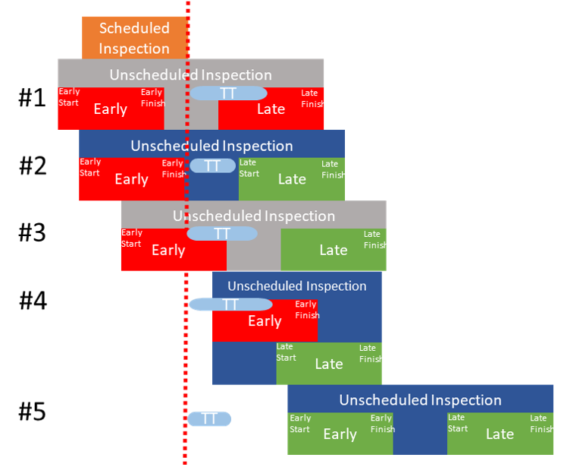
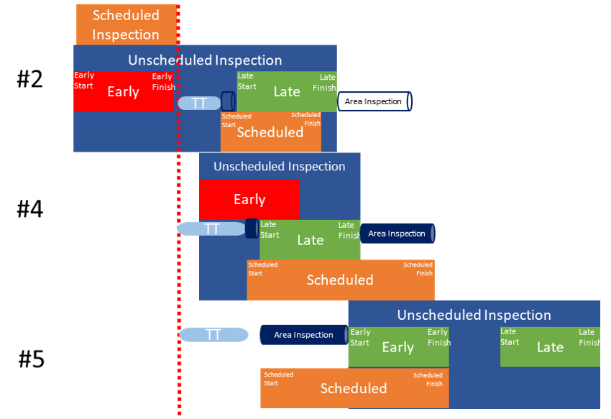
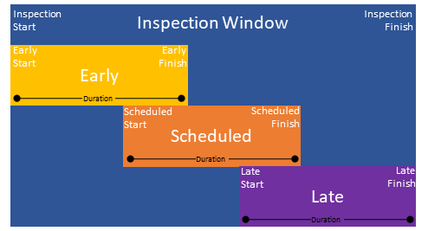

PIRP-C Approach - Sorting
Limit comparisons $n^{2}$ →${ n∗log }_{n}$
Consider Early and Late Start
Presort by Late Start
Notes:
The primary novelty of our new algorithm is to use pre-sorting by inspection late start.
By sorting we can limit reduce the comparisons from all-pairs to a window of 5 inspections.
The late start is the latest time we can begin an inspection within its blue inspection window, and be completed by the inspection window finish.
If someone inspects the property for 15 mins then the late start would be 15 mins before the inspection close.
The inspection might be started as early as the start of the window, based on the previous inspection, the scheduled times (in orange) happen anywhere between the early and late start times.
[CLICK]
If we consider a series of inspections, the previous inspection is in orange called "Scheduled Inspection", the red line is the finish time of the previous inspection.
TT is the travel time, the red boxes unviable times, green is are viable times.
A blue box shows the inspection is viable, a grey box shows it's unviable.
[CLICK]
In the last step, Area Inspections are added to durations. The clear cylinder represents is an area inspection previously conducted. The solid cylinders, still need to be done.

Slide 24
Overall Results
Score
Runtime
Notes:
Overall we found that the PIRP-C (in green, named here as Competitor) results in a higher score and shorter runtime than PIRP-ILS (in blue, named here as ILS) in both the average case and the worst case. The worst case is the first quartile for score, and the third quartile for runtime. Looking at both the average and worst case, shows us that there is a broad based trend in favour of PIRP-C.

Slide 25
Sensitivity Results
Score
Runtime
Ratio
Notes:
We compared the sensitivity, which we've previously discussed of a squared score, unchanged score and square rooted score.
PIRP-ILS performed best when the score is unchanged, both the score is maximised and the runtime is minimised.
PIRP-C performed best when the score is minimised and the time value is maximised.
In the last graph we divide the score, by every second of runtime taken. To give a sense of both the score and runtime in one figure. This is done for the remaining data features.

Slide 26
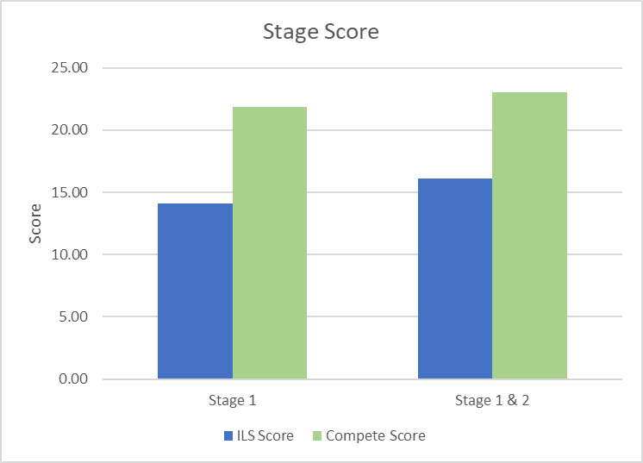
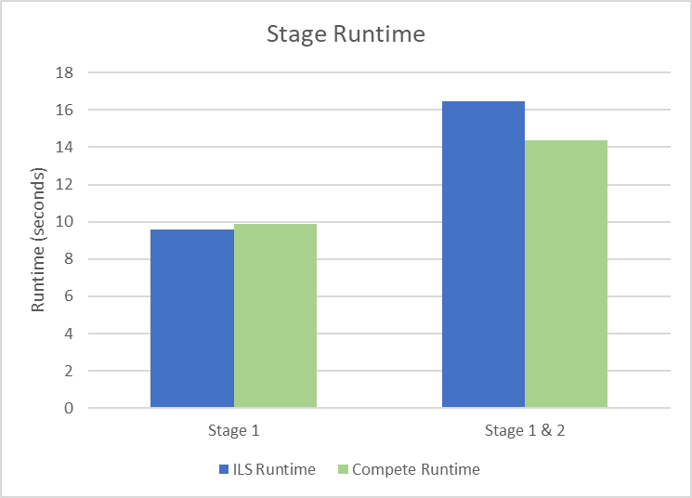

Stage Results
Score
Runtime
Ratio
Notes:
If we have a look at each stage of the algorithm operation, this is the Stage 1 – Construct Phase, and Stage 2 Improve phase.
Given stage 2 must have stage 1 to operate, the thing we measure is Stage 1 and 2 combined.
As you can see in the far left graph, we get a great score from Stage 1 of the PIRP-C algorithm, and a decent amount from PIRP-ILS.
The score is only incrementally increased for both algorithms.
In our second graph we see a similarly short runtime for Stage 1 for both PIRP-C and PIRP-ILS. And fairly long runtimes once we include Stage 2
If we look at the ratio, we can see there is a really potent effect of Stage 1 for the PIRP-C algorithm. So we've defined in our future work to look at replacing this stage 2 algorithm with a more potent approach.
Overall, I think the main reason why our Stage 1 construction step is so effective for PIRP is the more constrained time windows.
It's the same reason the more deterministic approach of PIRP-C is more effective than the stochastic approach of PIRP-ILS.

Slide 27
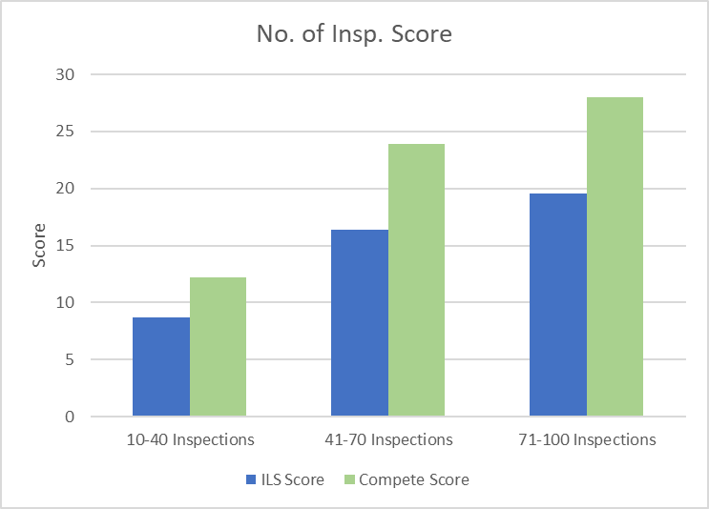
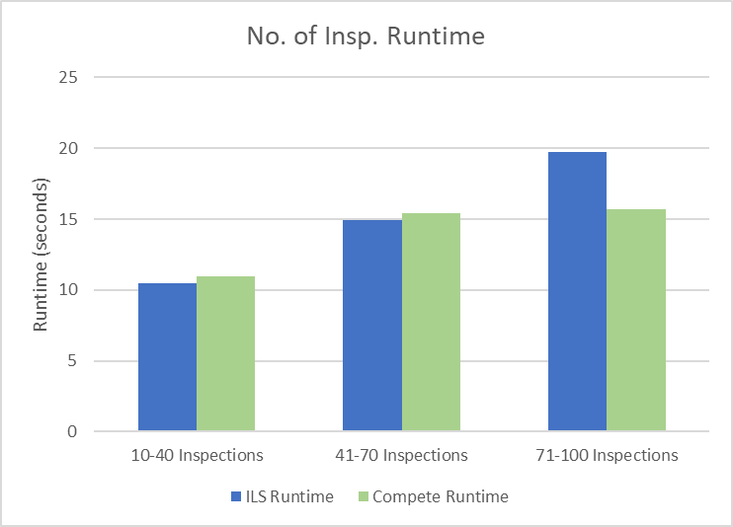
Number of Inspections Results
Score
Runtime
Ratio
Notes:
When we include more inspections in a dataset, perhaps unsurprisingly the scores increase as more available high quality inspections
Also the runtime increases as more comparisons happen, but has a bigger effect on PIRP-ILS, than the deterministic PIRP-C, which is echoed by the escalating ratio.

Slide 28
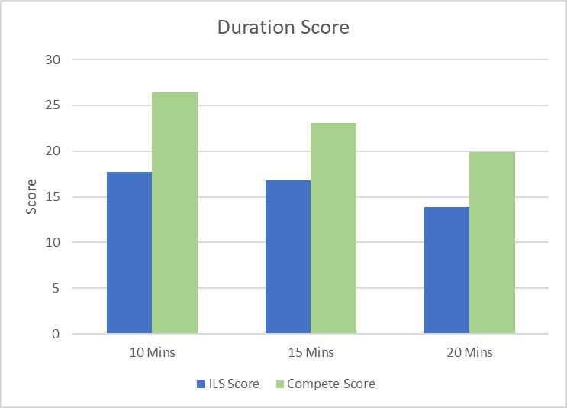
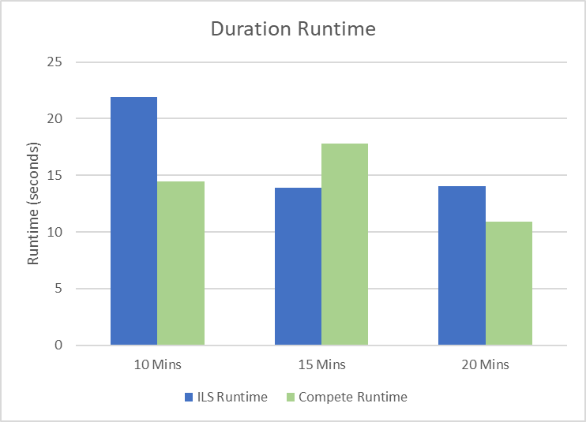
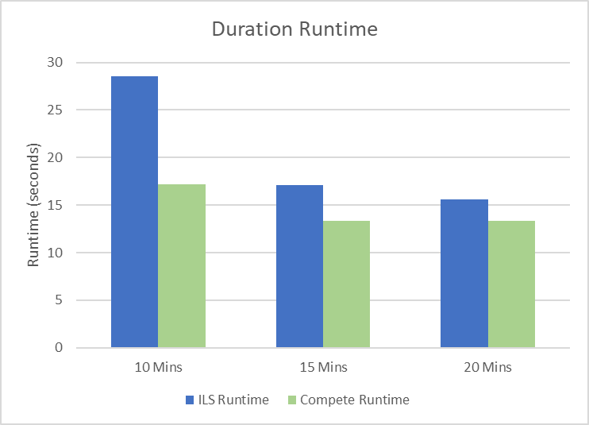
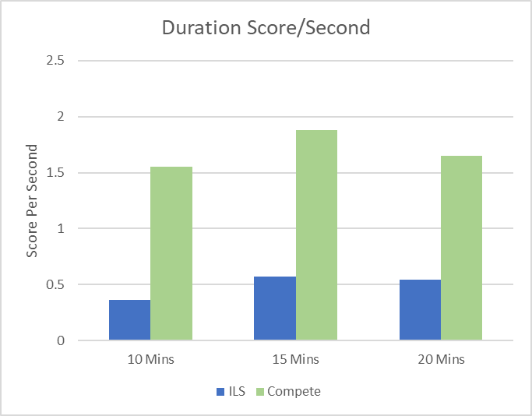
Inspection Duration Results
Score
Runtime
Ratio
Notes:
Conversely when we increase the amount of time in each inspection, we reduce the number of possible inspections to attend.
So the score is reduced.
Similarly the runtime is broadly reduced, with an interesting spike in PIRP-C runtime for 15 min inspections, that we couldn't explain.
This effects the ratio, but overall PIRP-C still performs better for the various situations.
Future work will consider if the 15 minute result is replicable. I think they will even out.
A preliminary re-analysis of the duration results indicate that runtime was actually less variable than published in the paper if extreme results are controlled for, as we see here.

